Slide 1
DKTES Textile and Engineering Institute, Ichalkaranji. Final Year B. Tech. (Semester – VII) Artificial Intelligence & Data Science ADL405: TIME SERIES ANALYSIS AND FORECASTING

Slide 2
Unit I - INTRODUCTION TO FORECASTING

Slide 3
Use of Data Transformations and Adjustments
Transformations
Data transformation refers to the process of converting, cleaning, and manipulating raw data into a structured format that is suitable for analysis or other data processing tasks.
it involves converting raw time series data into a format that is suitable for analysis and modelling.
Types of transformations
In univariate time series data, there are mainly four main types of transformations, that are used to make our data fit for model building.
They are :
Power Transform
Difference Transform
Standardization
Normalization

Slide 4
1. Time Series Data Transformation Using Power Transform:
The power transform is mainly used to make the variance of the data constant. It involves mathematically transforming the data so it changes its distribution to be more Gaussian (normal). This can be particularly useful in cases where the data has a skewed distribution or heteroscedasticity (varying variance).
from sklearn.preprocessing import PowerTransformer
# Compute variance of the original 'Temperature (C)' column
original_variance = df['Temperature (C)'].var()
# Apply power transform to 'Temperature (C)' column
pt = PowerTransformer(method='yeo-johnson')
df['Temperature (C)'] = pt.fit_transform(df[['Temperature (C)']])
# Compute variance of the transformed 'Temperature (C)' column
transformed_variance = df['Temperature (C)'].var()
print("Original Variance:", original_variance)
print("Transformed Variance:", transformed_variance)

Slide 5
2. Time Series Data Transformation Using Difference Transform:
The difference transform is a technique used to make a time series data stationary by computing the differences between consecutive observations. This transformation is useful for removing trends or seasonal patterns in the data, making it easier to model using techniques like ARIMA.
from sklearn.preprocessing import PowerTransformer
# Compute variance of the original 'Temperature (C)' column
original_variance = df['Temperature (C)'].var()
# Apply power transform to 'Temperature (C)' column
pt = PowerTransformer(method='yeo-johnson')
df['Temperature (C)'] = pt.fit_transform(df[['Temperature (C)']])
# Compute variance of the transformed 'Temperature (C)' column
transformed_variance = df['Temperature (C)'].var()
print("Original Variance:", original_variance)
print("Transformed Variance:", transformed_variance)

Slide 6
3. Time Series Data Transformation Using Standardization:
Standardization, also known as z-score normalization, is a preprocessing technique used to scale the features of a dataset to have a mean of 0 and a standard deviation of 1. This transformation can be useful when working with features that have different scales, as it helps to bring all features to a similar scale.
from sklearn.preprocessing import StandardScaler
# Create a StandardScaler object
scaler = StandardScaler()
# Fit the scaler to the data and transform the 'Humidity' and 'Pressure (mbar)' columns
df['Humidity standardized'] = scaler.fit_transform(df[['Humidity']])
df['Pressure standardized'] = scaler.fit_transform(df[['Pressure (mbar)']])
# Display the transformed DataFrame
print(df[['Humidity standardized', 'Pressure standardized']].head())

Slide 7
4. Time Series Data Transformation Using Normalization
Normalization is another data preprocessing technique used to scale the features of a dataset to a fixed range. This is achieved by subtracting the minimum value of the feature and then dividing by the range of the feature. Normalization is particularly useful when the features have different ranges and unit.
from sklearn.preprocessing import MinMaxScaler
# Create a MinMaxScaler object
scaler = MinMaxScaler()
# Fit the scaler to the data and transform the 'Humidity' column
df['Humidity normalized'] = scaler.fit_transform(df[['Humidity']])
# Display the transformed DataFrame
print(df['Humidity normalized'].head())

Slide 8
Trend and Seasonal Adjustments
Seasonal Adjustment
Seasonal adjustment is a statistical technique used to remove the effects of regular, repeating patterns (seasonal variations) from a time series dataset.
Seasonal variations refer to the predictable fluctuations or patterns that occur at specific intervals, often corresponding to certain times of the year, months, weeks, or days.
These patterns can obscure the underlying trends and make it challenging to analyze the true behavior of the data.
regression model describing the trend component to the data and then subtracting it out of the original observations, leaving a set of residuals that are free of trend.

Slide 9
he primary goal of seasonal adjustment is to isolate and understand the non-seasonal components of a time series, such as trends and irregular fluctuations.
This process allows for a clearer analysis of the underlying patterns, making it easier to identify long-term trends, make accurate forecasts, and detect unusual events.

Slide 10
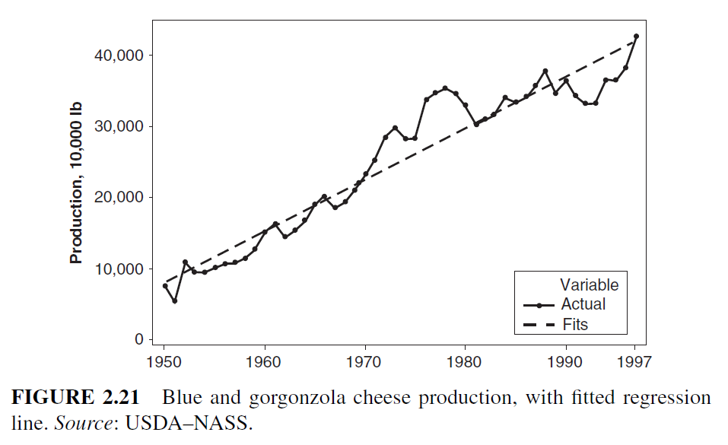

Slide 11
Key steps in seasonal adjustment include
Identifying Seasonal Patterns:
Analyze the time series to identify repeating patterns that occur at regular intervals. These patterns may be related to seasons, holidays, or other periodic events.
Decomposition:
Decompose the time series into its different components, typically separating it into trend, seasonal, and residual (error) components. The trend represents the long-term movement, the seasonal component captures the repeating patterns, and the residual component includes the irregular fluctuations.
Adjustment:
Adjust the time series by removing or smoothing out the seasonal component.

Slide 12
Decomposing Time Series
Seasonality in time series can be represented by breaking it down into a trend component, a seasonal component, and an irregular component. There are several methods to decompose a time series into its trend, seasonal, and residual components. The most common approach is Additive Decomposition.
Additive Decomposition
Y_t = T_t + S_t + E_t
where,
Y_t is the actual value of the time series at time t.
T_t is the trend component at time t.
S_t is the seasonal component at time t.
E_t is the irregular(error) component at time t.

Slide 13
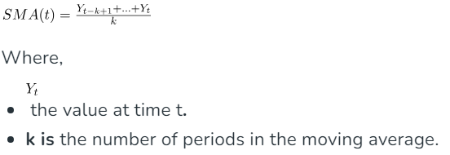
Trend Estimation
Compute the moving average to capture the trend. We can use a simple moving average or other techniques like exponential smoothing. Here, we’re using moving average.
The trend component represents the long-term movement or underlying growth/decay pattern in the time series. It reflects the overall direction in which the time series is heading, abstracting from short-term fluctuations.
The moving average is computed by taking the average of the values over a specified number of periods, which is m in this case.
Notes:
https://www.geeksforgeeks.org/seasonal-adjustment-and-differencing-in-time-series/

Slide 14
Why it is important to adjust seasonal variation?
Seasonal changes are important for a number of reasons:
Finding Trends and Cycles:
Comparing Data Points:
Forecasting and Analysis:
Notes:
https://www.geeksforgeeks.org/seasonal-adjustment-and-differencing-in-time-series/

Slide 15
Advantages of Seasonal Adjustment
Better Forecasting: By exposing underlying patterns and trends that are independent of seasonal variations, seasonal adjustment enables more accurate forecasting.
Improved Trend Analysis: By separating the impacts of seasonality, it makes it easier to comprehend and analyze long-term patterns in the data.
Comparability: Since seasonal influences are eliminated, seasonally adjusted data facilitates the comparison and analysis of various time periods.
Disadvantages of Seasonal Adjustment
Assumption of Consistency: Seasonal adjustment is predicated on the idea that seasonal patterns would stay mostly unchanged over time. This assumption may not hold true if there are substantial changes in the underlying environmental or economic circumstances.
Data Smoothing: The data is smoothed throughout the seasonal adjustment process, which may cause certain short-term swings to be lost and make it more difficult to spot abrupt shifts or abnormalities.
Complexity: The implementation of some sophisticated seasonal adjustment methods might be challenging and call for a solid grasp of statistical methodology.

Slide 16
Seasonal Adjustment and Differencing Implementation Librarues
!pip install pandas
!pip install statsmodels
!pip install matplotlib

